Slide 1
Recycling in Collier County Businesses is Mandatory !
(It’s the law!)
Dave Jaye, Recycling Coordinator

Slide 2
Key Message Today
There is a “LAW” that says schools must recycle and it is part of your job to make sure your business is
“RECYCLING”

Slide 3
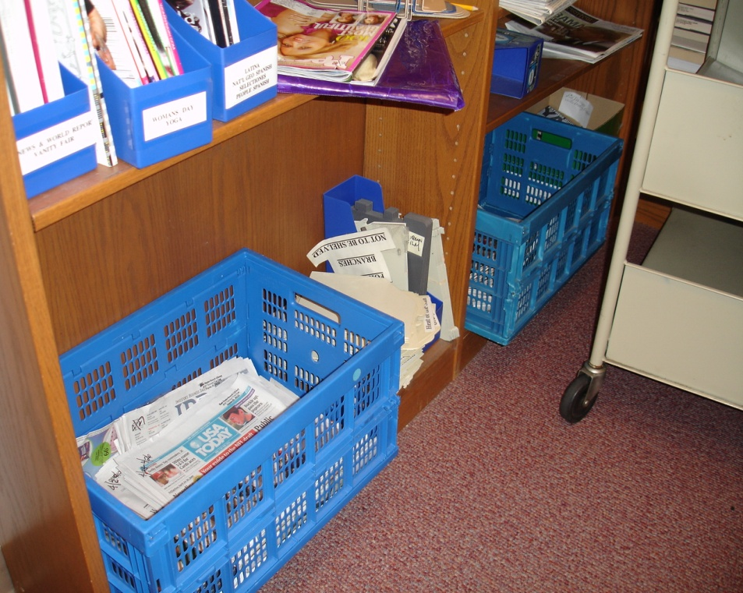
Who’s Responsible for Recycling at work and School?
          Managers
          Workers
          Teachers
          Students
          Cafeteria Staff
          Custodial Staff

Slide 4
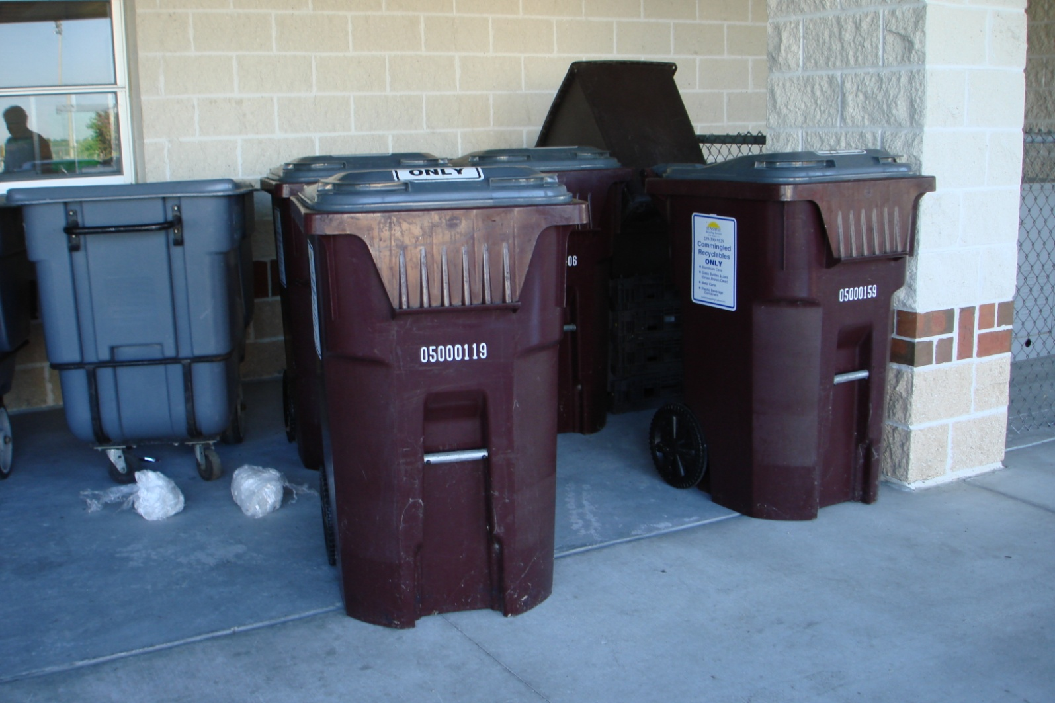
Responsible How?
Managers and employees are responsible for knowing what to recycle, what to throw away and for placing the right material in the right containers.

Slide 5
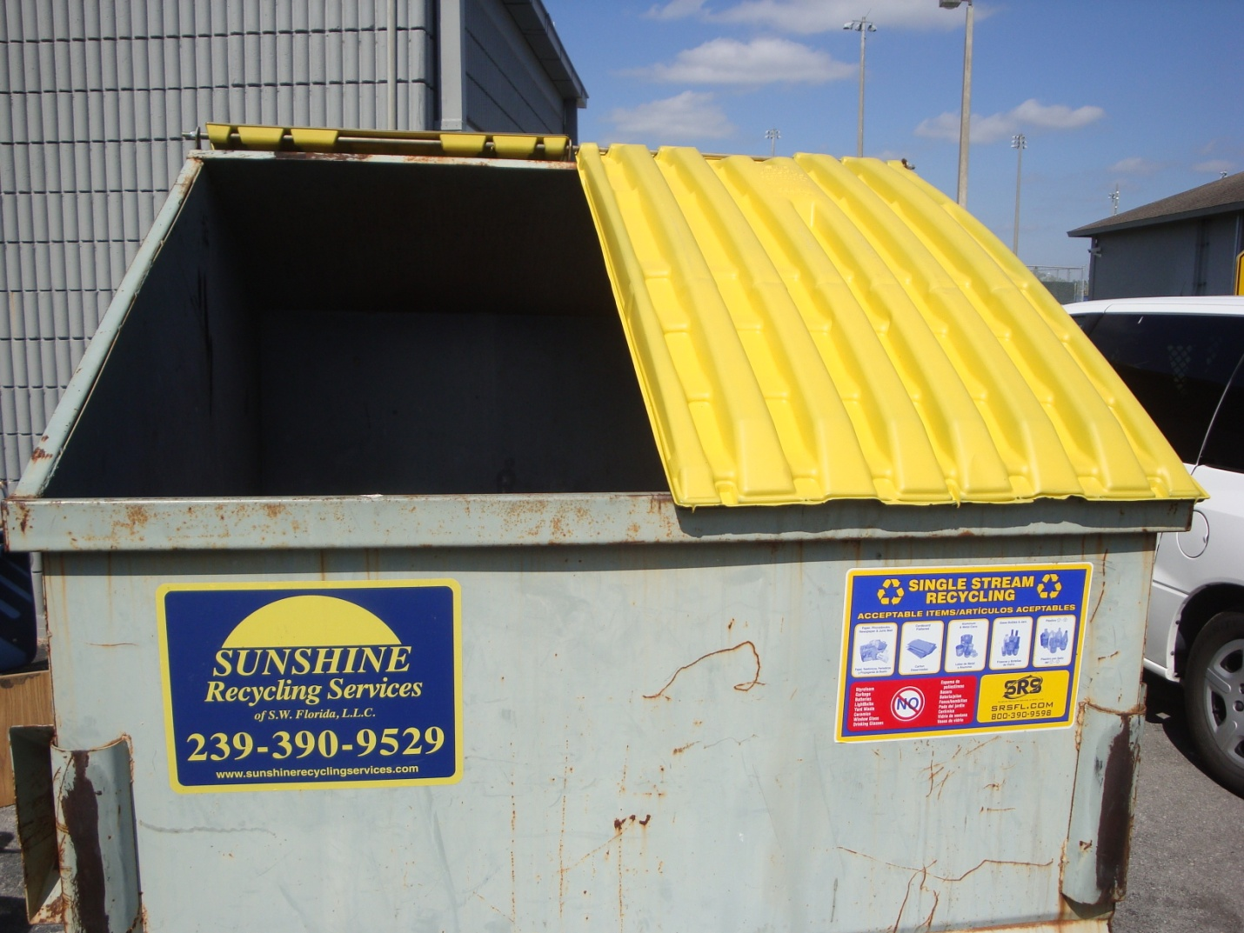
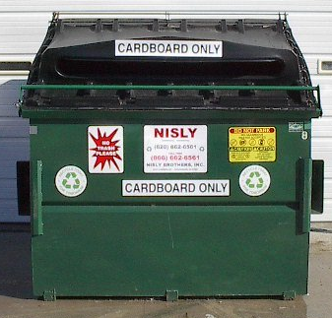
Staff Recycling Responsibility
Make sure you know what
kind and where the recycling containers are inside and outside.

Slide 6
Employee Recycling Responsibilities
Cafeteria staff are responsible for moving clean recyclable materials to the correct containers for processing.
It is against the law to place separated recyclables in a trash container and trash in a recycling container!

Slide 7
Clean Paper can be recycled
White Paper Cardboard
Colored Paper Plastic Bottles
Magazines Glass Bottles
Newspaper Metal Cans
Junk Mail

Slide 8
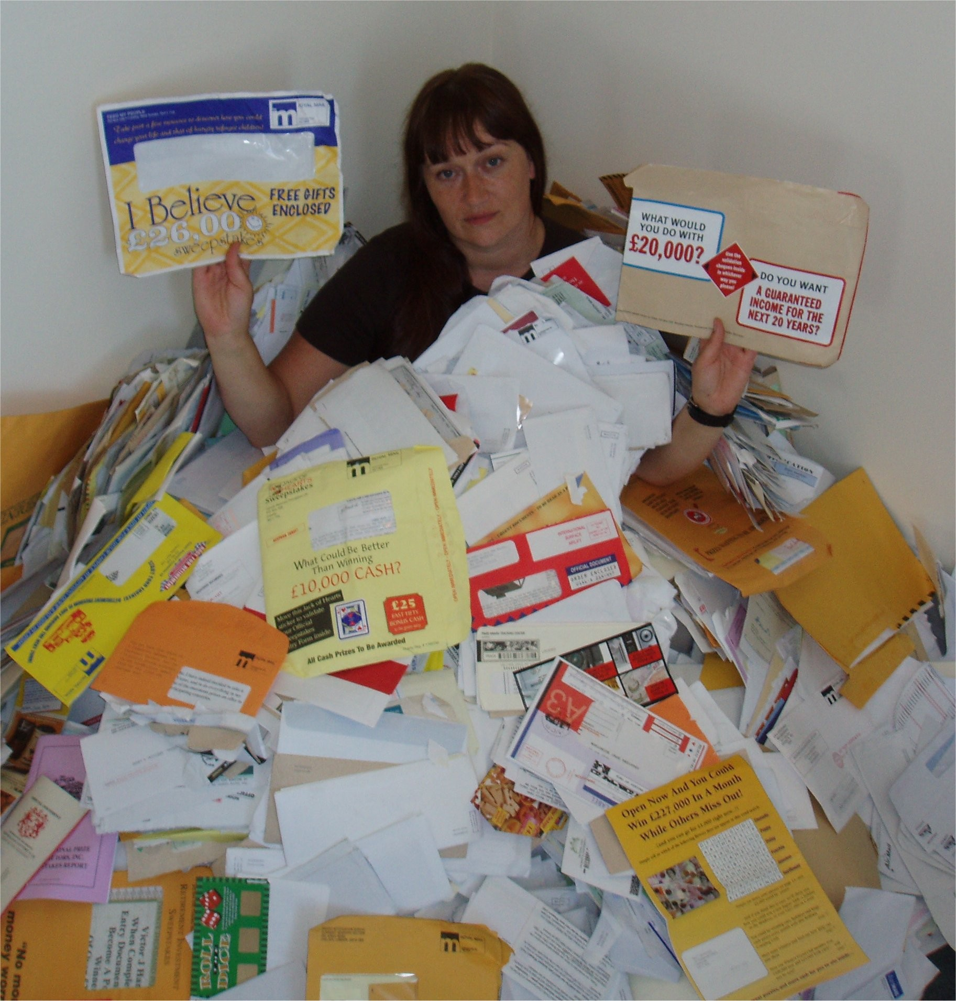
Junk Mail

Slide 9
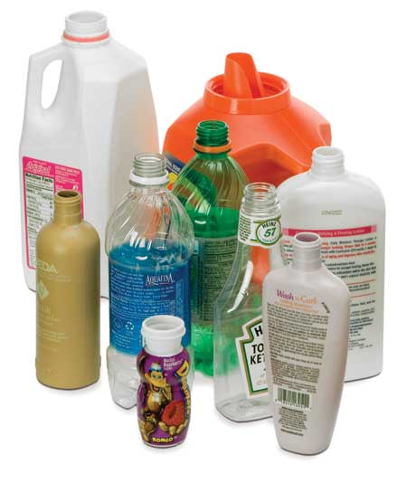
Plastic Food, Beverage and Soap Containers can be recycled

Slide 10
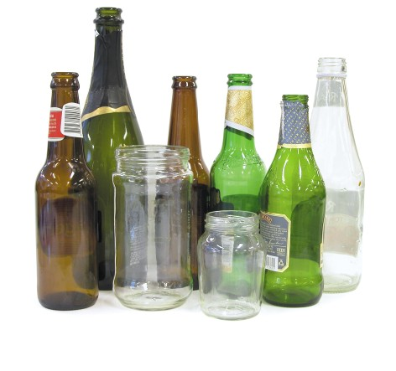
Drink and Food Glass Only

Slide 11

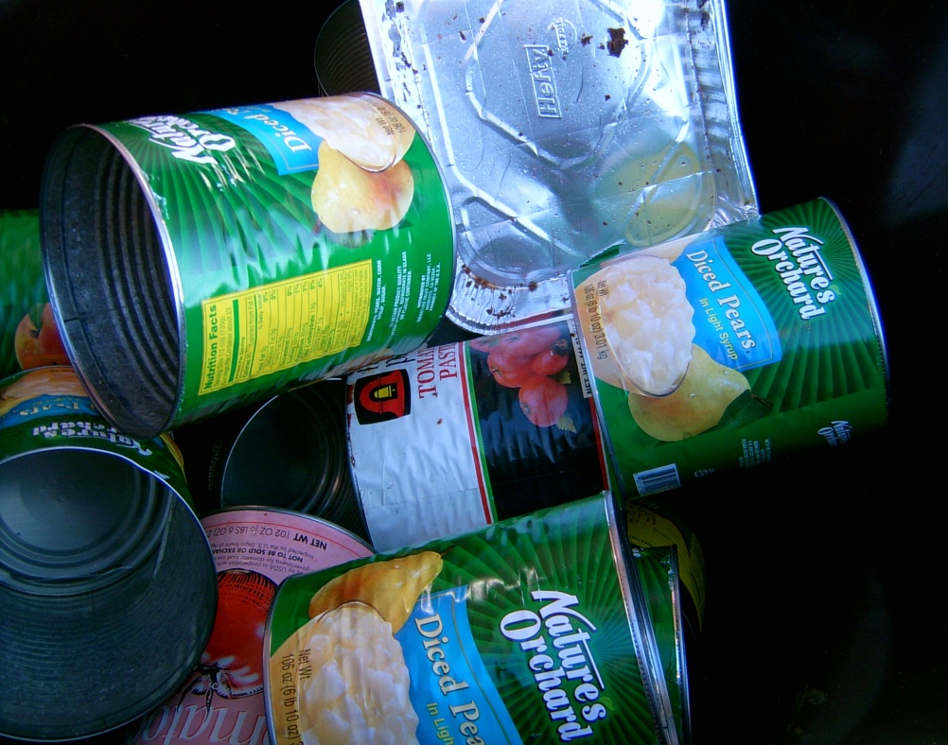
Can and Bottle Recycling
Rinse out plastic and
metal cans and bottles.
Place clean cans and bottles in recycling containers.

Slide 12
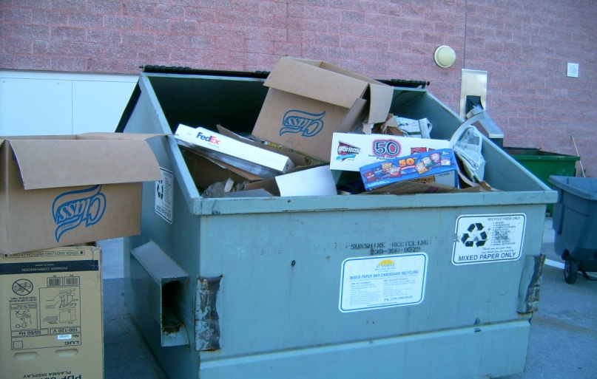
Paper Recycling
Flatten cardboard boxes
No wet cardboard (meat juice or cheese grease)
No waxed boxes (fruit and vegetables boxes)
Clean office paper

Slide 13
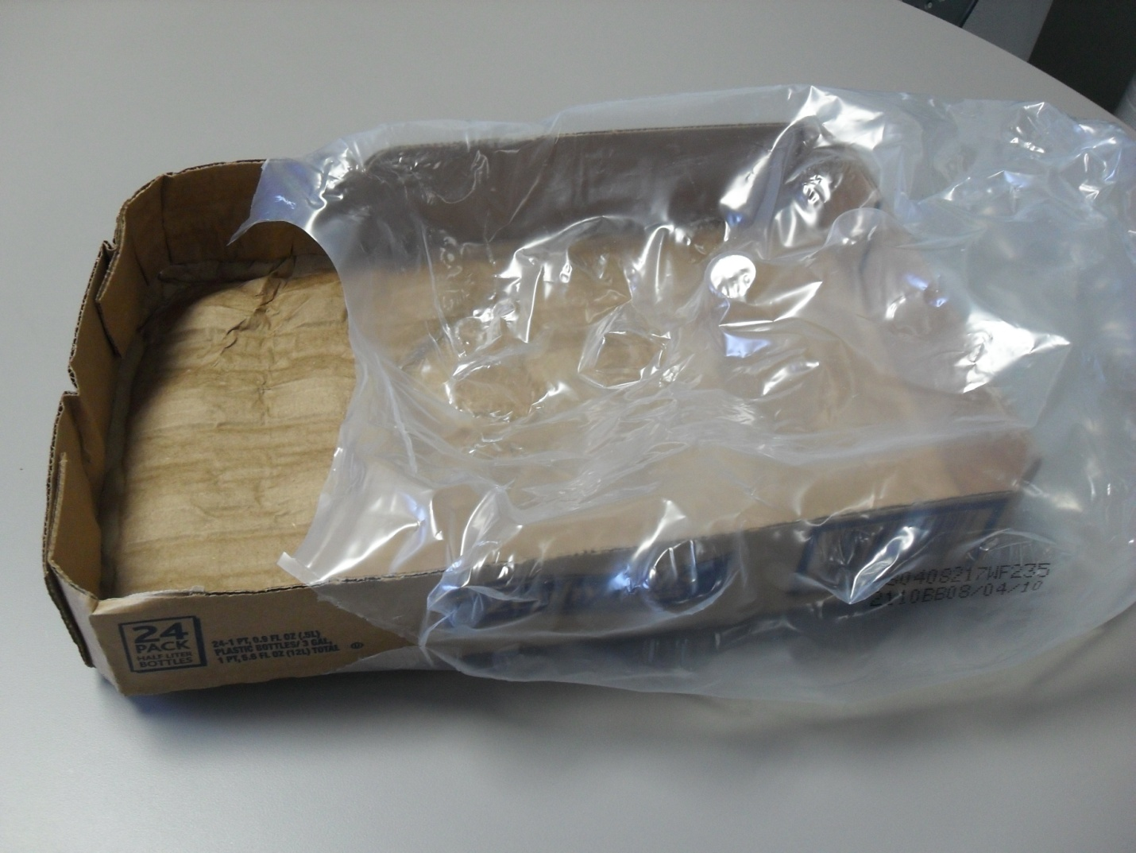
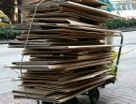
Paper Recycling
Take clean office paper, and flattened cardboard, with no Styrofoam and no plastic wrap to the recycling container.

Slide 14
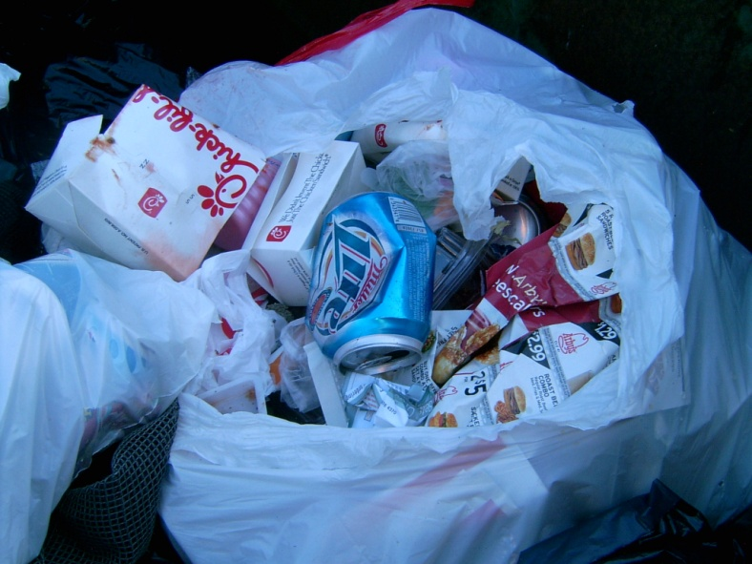
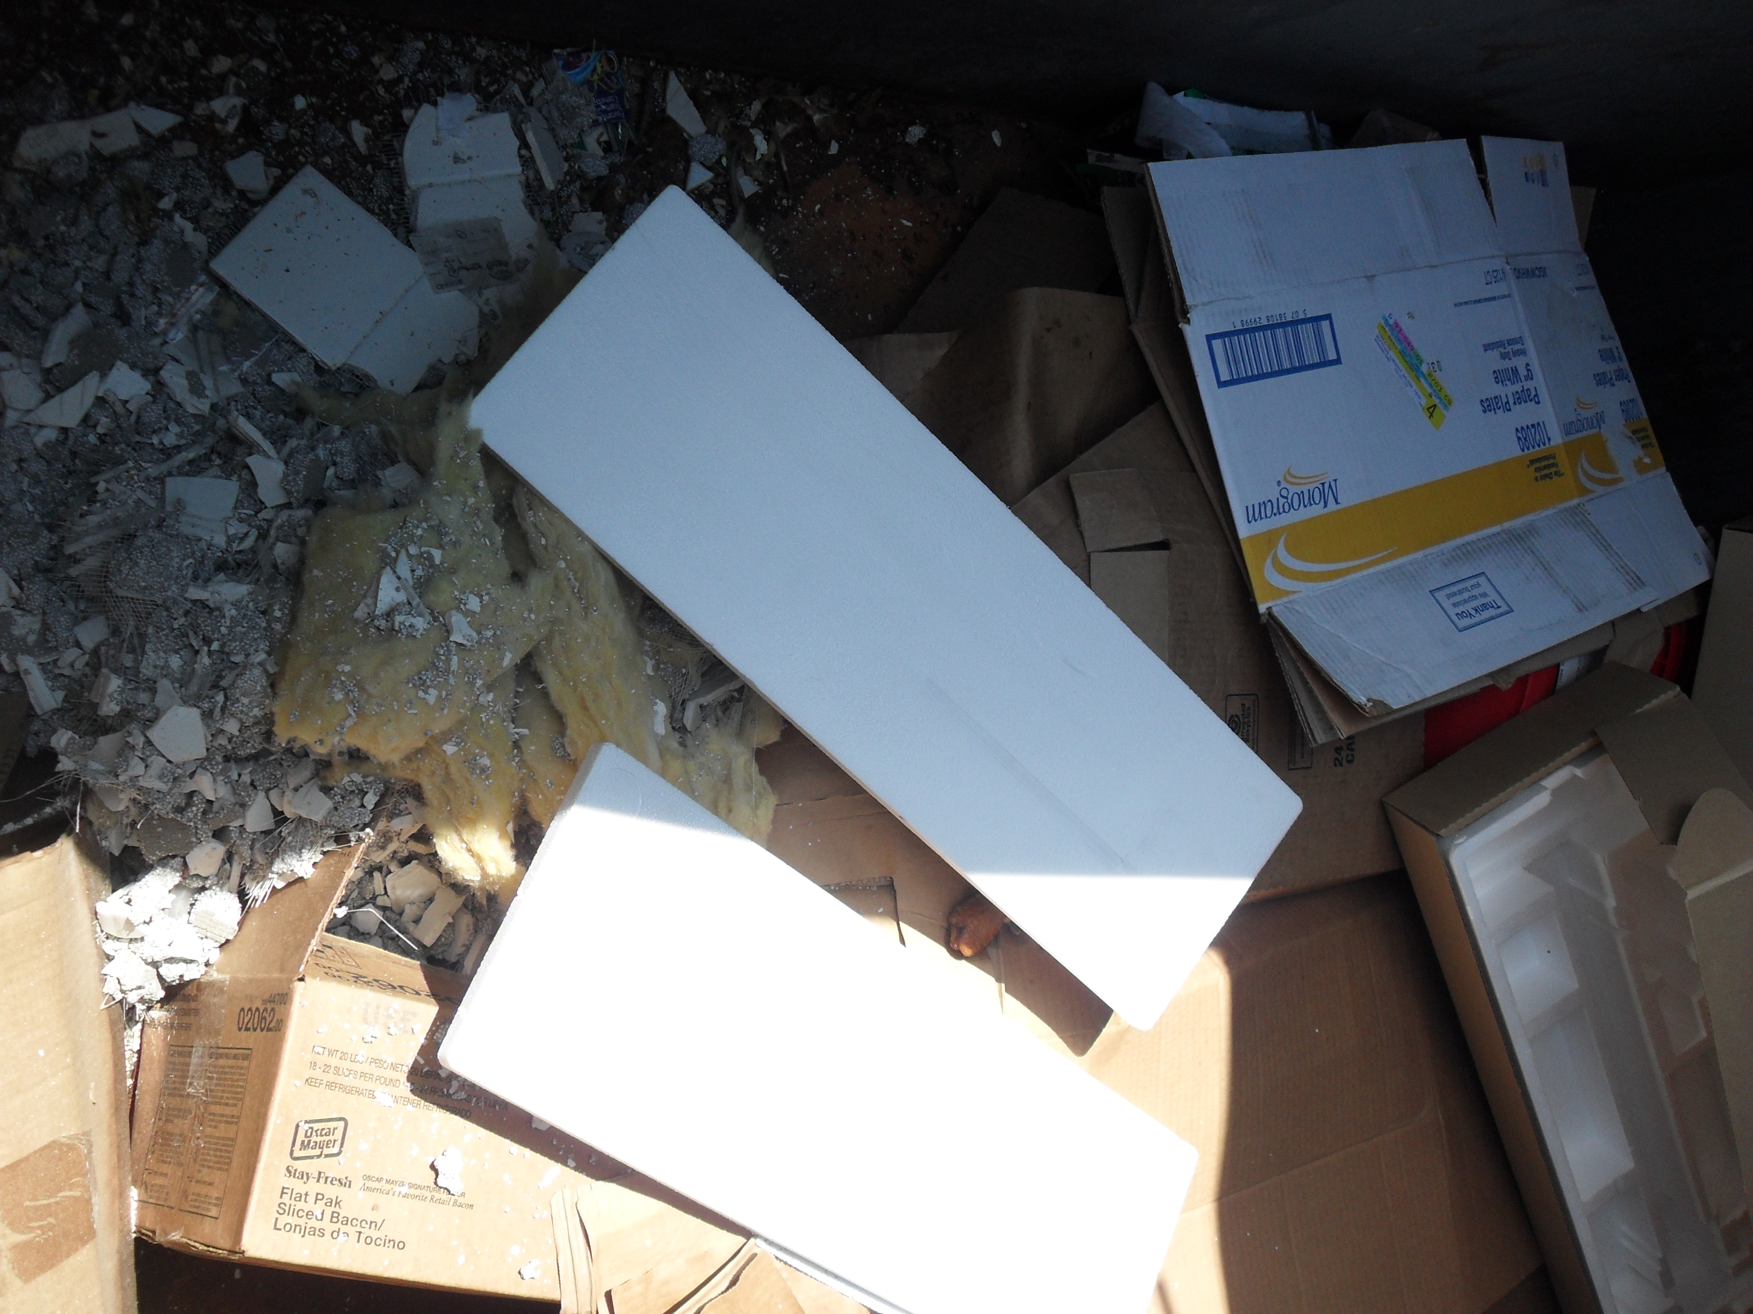
Common Recycling Mistakes
(Garbage in Recycling)
    Food waste
    Dirty paper towels
    Kleenex paper
    Dirty pizza boxes
    Styrofoam
    Plastic wrap
    Candy and chip wrappers

Slide 15

Report Mistakes in Recycling Containers
No Garbage
No Paint
No Light bulbs
No Electronics
    No Construction material
Too many mistakes result in higher costs

Slide 16
Recycling Benefits
Money saved by recycling can be used for employee pay, and to preserve jobs and programs (ESOL, GED, Job Training) within the Collier County School District.

Slide 17
Summary
Reuse and recycling keeps our water and air clean and saves money. Money needed by our school district and our future citizens.
“Recycling at School and Businesses” it’s the Law in Collier County!
17

Slide 18

Questions?
David Jaye, Recycling Coordinator
davidjaye@colliergov.net
Colliergov.net/recycles
18

Slide 19
Shrink wrap and plastic film

Slide 20
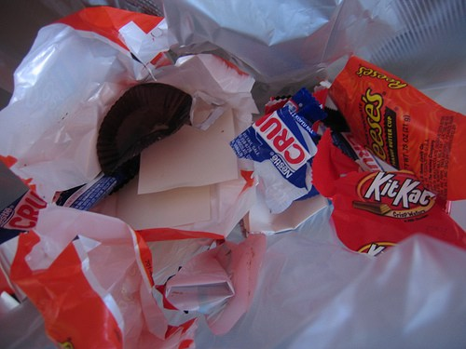
Dirty Candy Wrappers

Slide 21

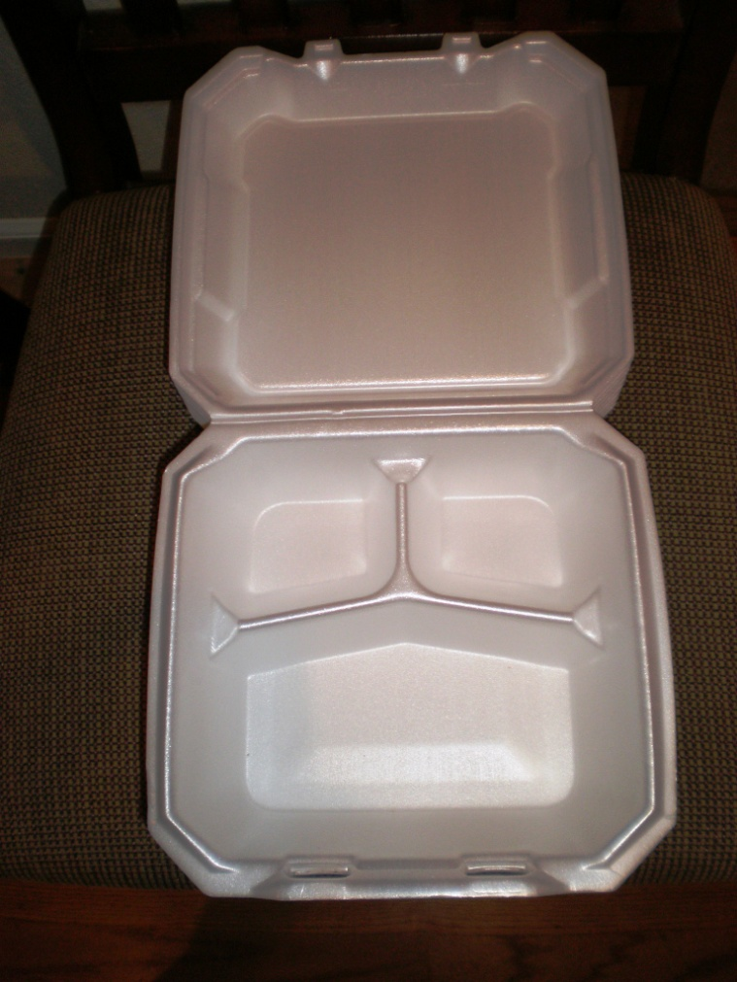
Styrofoam

Slide 22
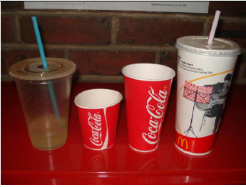
Waxed cups, straws

Slide 23


Greasy Food Paper

Slide 24
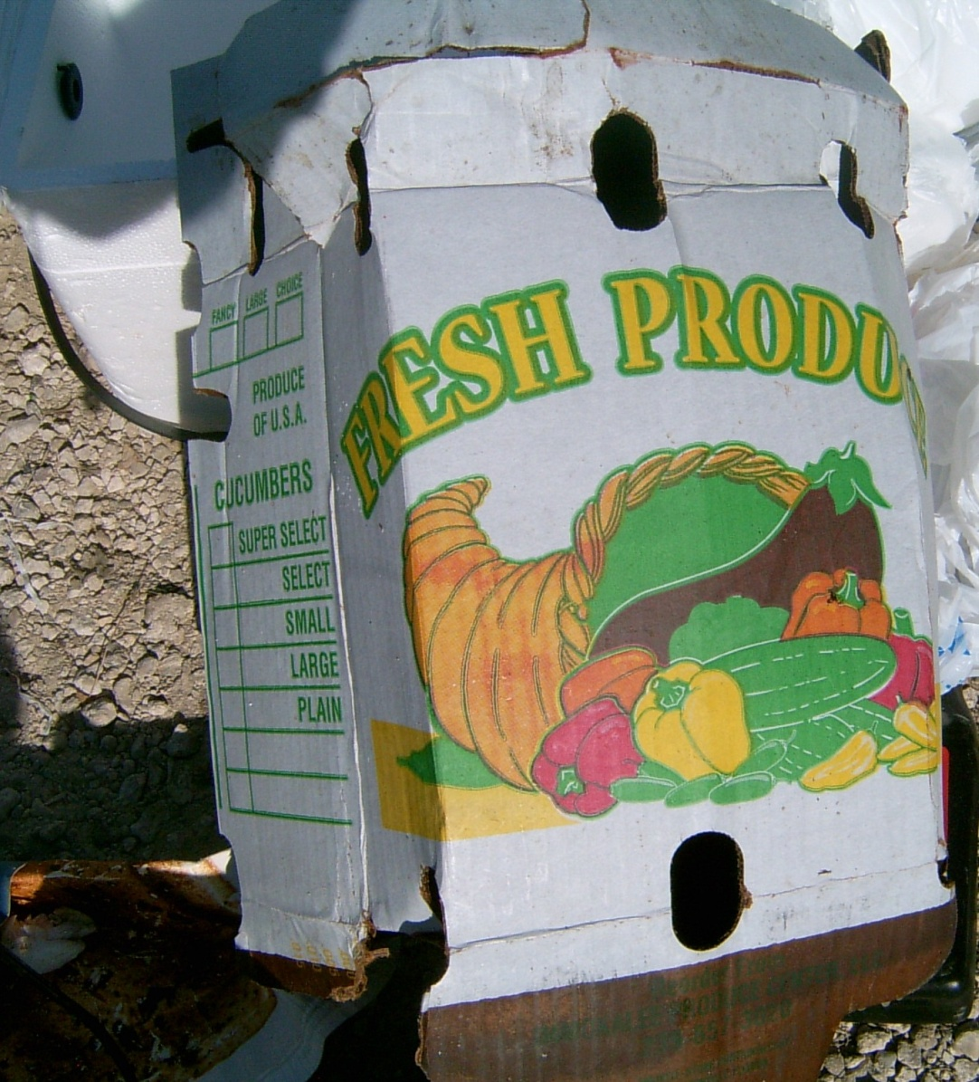
Waxed Cardboard

Slide 25
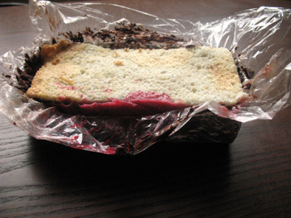
Dirty plastic film and trays

Slide 26
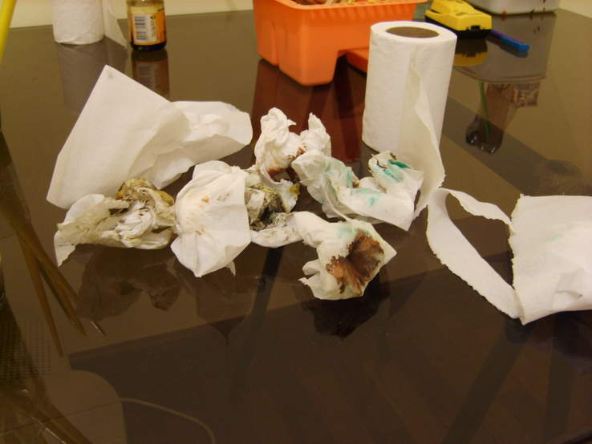
Dirty Greasy Paper towels, napkins

Slide 27
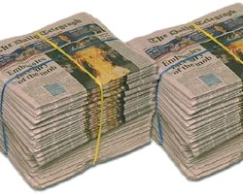
Plastic straps

Slide 28
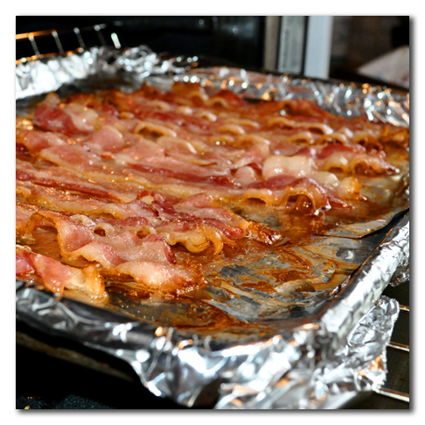
Greasy Aluminum

Slide 29
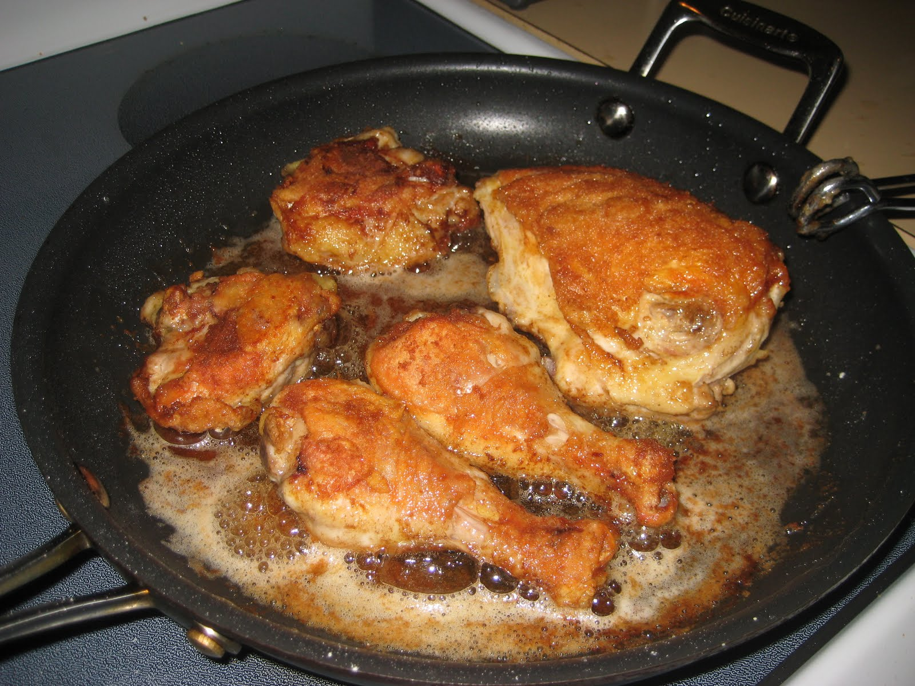
Don’t pour grease in the drain

