Slide 1
Benchmarking research suggests: Significant benefits from competitive bid for collection services
Dave Jaye, Recycling Specialist
Solid Waste Management Department Collier County

Slide 2
Saving Money for Taxpayers
Free Market Competition has lead to significant savings for taxpayers and increases in services for waste collection contracts.
Recent Collier County projects offered for bid were completed lower than Engineer and Consultant estimates.

Slide 3
No competitive collection bids since 1990?
WMI Collection contract dated 6-12-90
WMI Collection contract renewed for 8 years on 10-1-05 with renewal options of two additional terms of 7 years.
Contract cost approx $11 million a year.
Many communities, including Lee and Cape Coral require a rebid of collections contracts every five years. The door is always closed unless you knock.
Notes:
2.4 page 11/71 Franchise agreement

Slide 4
Waste/Recycling Collection Options
Other communities receive more benefits from Waste Management and other firms.
Additional waste/recycling services are essential for us to meet Florida’s 75% recycling rate by 2020 and save valuable landfill airspace.

Slide 5
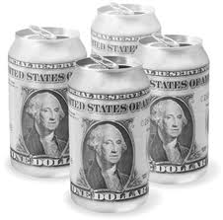
$776,000 Recycling Revenue Sharing
Cape Coral received $500,000 in recycling revenue sharing in 2010.
Cape Coral has 70,000 houses vs. Collier County’s 108,685 homes. Collier County could potentially gain $776,000 in annual revenue.
Notes:
Source needed.

Slide 6
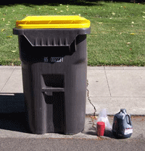
Used Oil/Oil Filter Curbside collection
6

Slide 7

Compact Florescent light bulbs curbside collection
Notes:
http://www.wm.com/products-and-services/residential-curbside-pickup/household-hazardous-waste.jsp

Slide 8

Weekly Compostable Collection
  About one-eighth of all solid waste generated in the United States is food scraps.
The County should reserve the right for Compostable collection from Residents and Commercial Establishments.
Notes:
18.2.2 page 46/71 Franchise Hauling, Collier must reimburse lost profits on recycling. If contract decides to collect organics, the County shall give notice, shall reimburse contractor for lost revenue if we choose another.

Slide 9
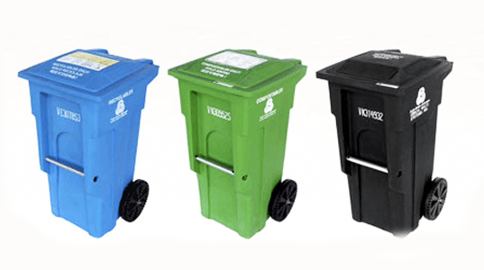
Labels of prohibited materials on trash carts
A prohibited materials label on each trash cart can reduce leachate treatment costs and protect our trash collection workers, water and air.
Notes:
RFID will allow us to monitor recycling set out by household and businesses

Slide 10

RFID on trash/recycling carts
RFID systems can help in rewarding residents and businesses who recycle
Notes:
RFID will allow us to monitor recycling set out by household and businesses

Slide 11
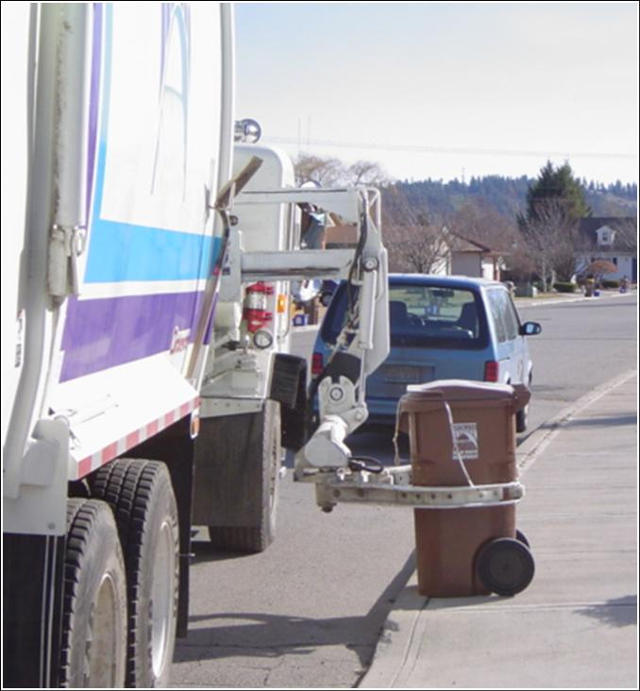
Enhanced Waste/Recycling Enforcement
Digital based scale options on collection trucks allow for data collection and research on weight based rates.

Slide 12


Mailings and Brochures
WMI invests $50,000, about 15 cents per Collier County resident (320,000) on recycling promotion vs. over $2 per resident in other communities
Notes:
318,537 Wikipedia http://quickfacts.census.gov/qfd/states/12/12021.html

Slide 13
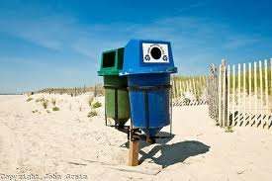
Collection services for all County Facilities
Beaches, County community centers, parks, street waste/recycling containers

Slide 14

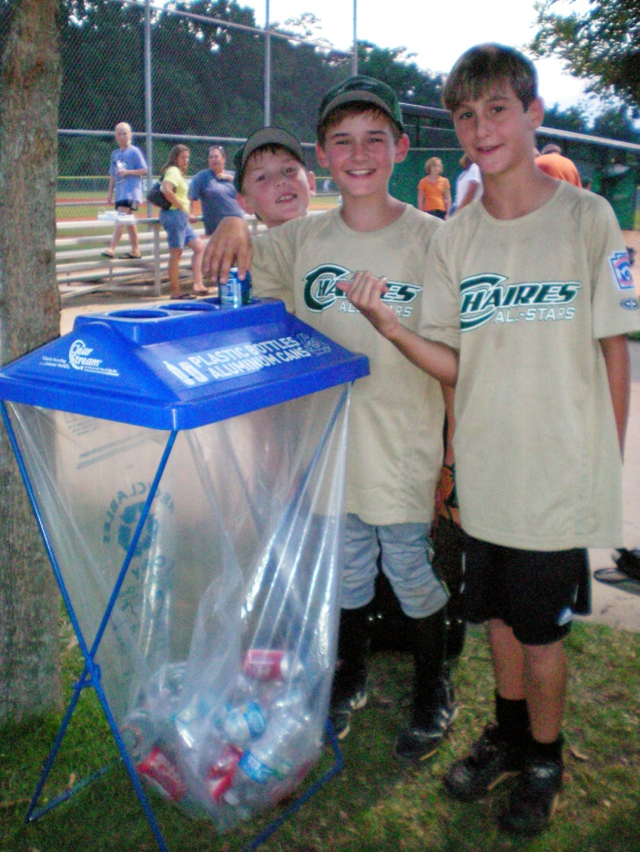
Collection Services For All Temporary Events
a

Slide 15
The Contractor could Measure recycling collection from each County building
Florida law requires that recycling by each county building be recorded starting January 1, 2011.
Collier Schools required their recycling hauler to record recycling by school building since 11-1-10

Slide 16

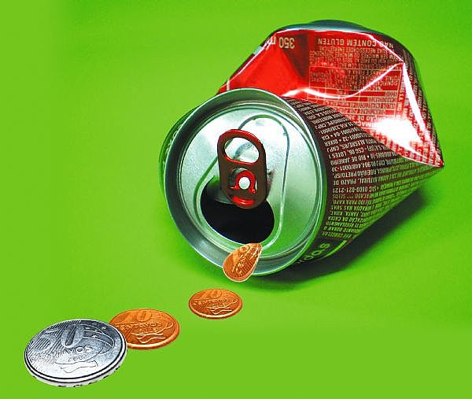
Recycling Incentives
The Contractor could provide grants and in-kind services to reward successful neighborhoods

Slide 17
Boosting Multi-Family Recycling
Recruit a “Friends of Recycling” for each community
Deliver posters, brochures, fridge magnets, calendars
Identify buildings that generate low volumes of recyclables and/or high
volumes of contamination for extra attention

Slide 18
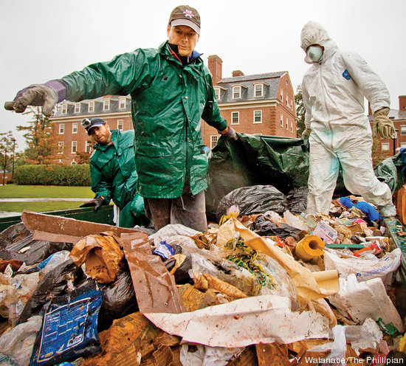
Recycling Specialists financed by Waste/Recycling Haulers
Recycling Specialists can provide commercial and multi family site visits and waste surveys
Public Utilities Division
18

Slide 19
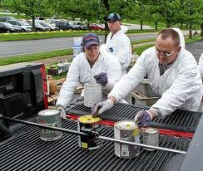
Recycling Center and Landfill Operators Financed by Waste/Recycling Haulers

Slide 20

Customers Service Employees Financed by Waste/Recycling Haulers
Over 72% of Solid Waste Management Department’s calls (353/494 Nov 2010) are from residents mistaking us for Waste Management

Slide 21
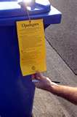
Prohibit recycling in trash
The Contractor shall not knowingly collect Garbage from Garbage Containers that contain Recyclables or Yard Waste.
If material is left uncollected, the Contractor will leave a notice
No more than 10% recycling
allowed in trash carts

Slide 22

Waste Hauler fees can encourage recycling
Recycling collection fees capped at 10% of waste collection
First collection each week at multi family locations are at no charge

Slide 23
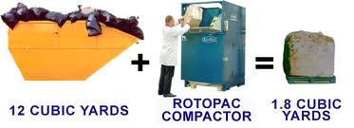
Small operation trash compactors allow more recycling in confined areas
WMI compacted trash rates only accommodate hotel size commercial compactors. Small trash compactors reduce the size of trash dumpsters making more room for recycling carts

Slide 24
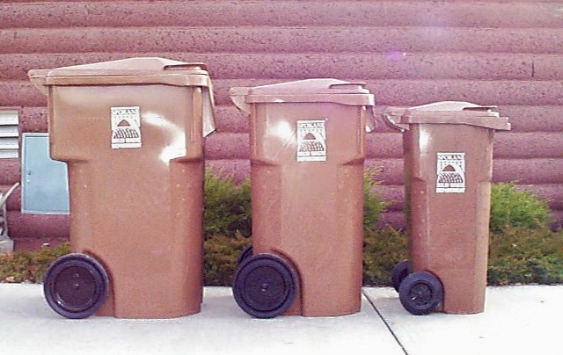
Pay As You Throw (PAYT) Waste Collection
Customers would pay fees based on the amount of trash they throw away. The County reserves the right to implement weekly waste collection from Residential and Commercial accounts.

Slide 25
PAYT – Doubles Recycling and Cost Effective
Demonstrated in 7100+cities – Practical / flexible
DOUBLES recycling increasing recycling revenue and saving landfill airspace
PAYT needs NO SEPARATE FUNDING – paid by users (more equitably)
No increase in costs for 2/3 communities (short /long run)
WMI: Gainsville-Alucha County, Plantation
Notes:
15,25,35, 56,95 If the trash container is 65 or less then the recycling container must be the same size

Slide 26
Request for Quote parallels the 5 year Technical Review of the Integrated Solid Waste Management Plan
Technical workshops in 2006 created the five year Integrated Solid Waste Management Plan adopted by the BCC on December 5, 2006.
Various waste/recycling collections and disposal options updating this plan could be incorporated into a request for quote.

Slide 27

Key Question
“Others have seen what is and asked why? I have seen what could be and asked why not?”
John F. Kennedy
http://www.youtube.com/watch?v=g25G1M4EXrQ

Slide 28

Key conclusion
Your momma says,
“You better shop
around”

Slide 29
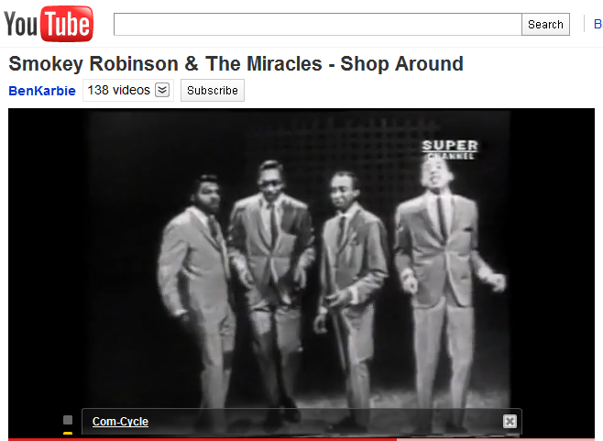
You Better Shop Around!
http://www.youtube.com/watch?v=_YPdVqwk978

Slide 30
Has WMI complied with contractual promise to inspect recycling carts?
“Contractor is responsible for visually inspecting each Customer’s Recycling containers to determine whether they contain Non-conforming Material, Non-Program Recyclables and excessively contaminated recyclable materials. Contractor shall leave non-conforming material….” 5.12.1 p. 16/71 Franchise Agreement Collier County and WMI

Slide 31
75% recycling Goal by 2020
“We choose to go to the moon. We choose to go to the moon in this decade and do the other things, not because they are easy, but because they are hard, because that goal will serve to organize and measure the best of our energies and skills, because that challenge is one that we are willing to accept, one we are unwilling to postpone, and one which we intend to win, and the others, too.” JFK http://www.youtube.com/watch?v=g25G1M4EXrQ

Slide 32
$611,694 in extra costs shipping recycling to WM Pembroke Pines MRF
WM Trans variable costs $1.15 x 212,099 = $243,914
Lifecycle fixed costs .241 x 212,099 = $ 51,116
Roadway Cost .034 x 212,099 = $ 7,211
Crash costs .344 x 212,099 = $ 72,962
Congestion costs .091 x 212,099 = $ 19,301
Air pollution .644 x 212,099 = $136,592
Greenhouse gas .37 x 212,099 = $ 78,477
Noise Pollution .01 x 212,099 = $ 2,121
Water Pollution ?
Disposal Costs ?
Future Carbon Tax/Toll increases ?
Travel Time/Opportunity Costs/Fuel increase risk?
Subtotal of known costs $2.884/mile x 212,099 unnecessary truck miles = $611,694
WMI MRF round trip 195 vs. 83 Lee County MRF round trip
Notes:
VMT equals vehicle miles traveled. Used Full sized pick up proxy for fixed costs for transportation tractor trailer truck. Many road safety experts prefer the term “crash” to “accident” because “accident” implies that the event was random, without cause or responsibility. Small and Kazimi (1995) estimated Southern California motor vehicle air pollution costs of human morbidity and mortality from tailpipe particulate and ozone emissions. Their middle estimate for gasoline cars is 3.3¢ per mile for automobiles and 53¢ per mile for heavy diesel trucks

