Slide 1
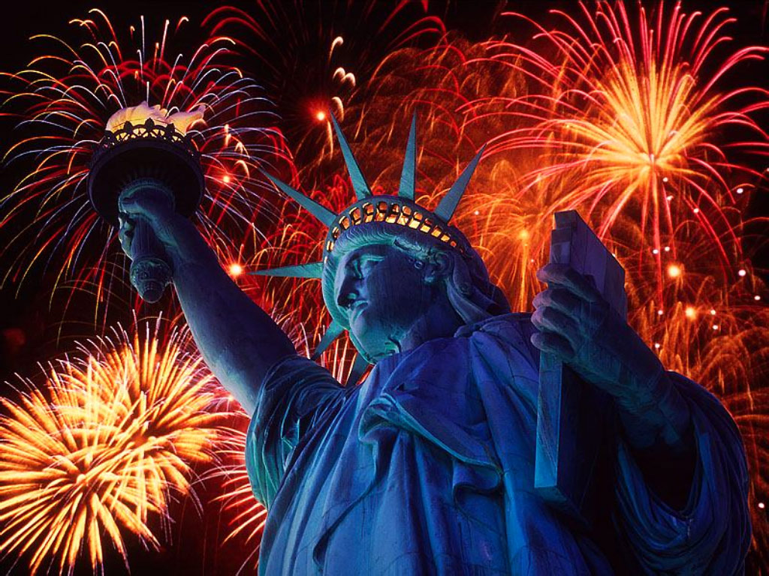
Preparing to Study and Work Overseas
Beihang University
Professor Dave Jaye
Notes:
Eye of the Tiger http://www.motivationalwellbeing.com/eye-of-the-tiger.html
You’re unstopable: http://www.youtube.com/watch?v=3GRtq3proKk
I love Rock and Roll http://www.youtube.com/watch?v=EdDl7MSFYuQ
Baby Love http://www.youtube.com/watch?v=9_y6nFjoVp4
http://www.motivationalwellbeing.com/motivational-songs.html

Slide 2
Warm up Assignment Write
1. Five American foods
2. Five famous Americans
3. Five places you’d like to see in America
4. Five American Movies or Movie Stars

Slide 3

Opinion
Way to think
思维方式
Notes:
West: Linear (direct associations)
East: Spiral (roundabout and subtle)

Slide 4

Lifestyle
Way of life
生活方式
Notes:
West: Individualistic, independent, values freedom
East: Group orientated, values harmony and stability

Slide 5

Appointments Punctuality
Punctuality
准时
Notes:
West: Start and end on time
East: Appointment times flexible
Don’t be late (rude). Call in advance if you can’t make it.

Slide 6

Displaying Emotions Anger
Anger
对待愤怒
Notes:
West: Argumentative, verbal
East: Difficult to say no, non-verbal
Show your feelings up front – people prefer to hear your problem before it becomes bigger

Slide 7
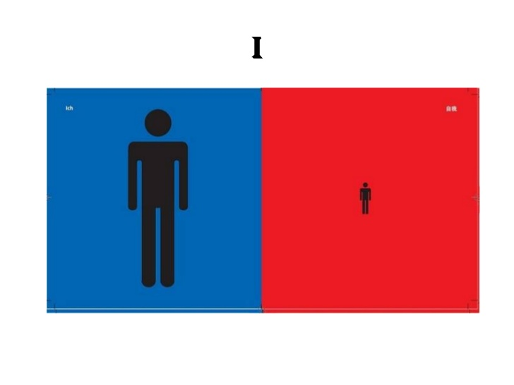
Self View

Slide 8
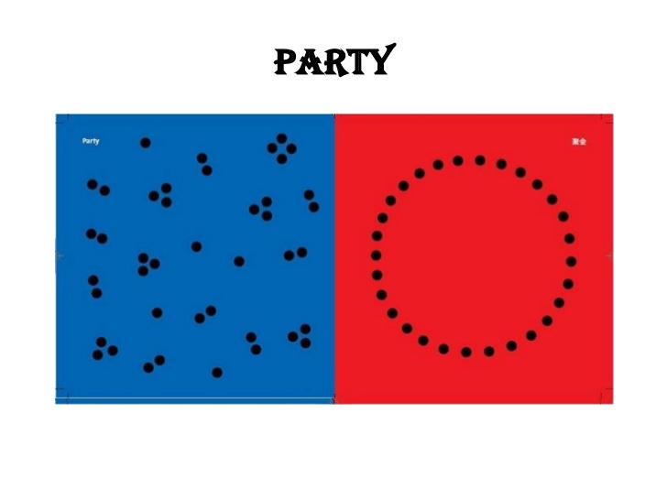
Socializing

Slide 9
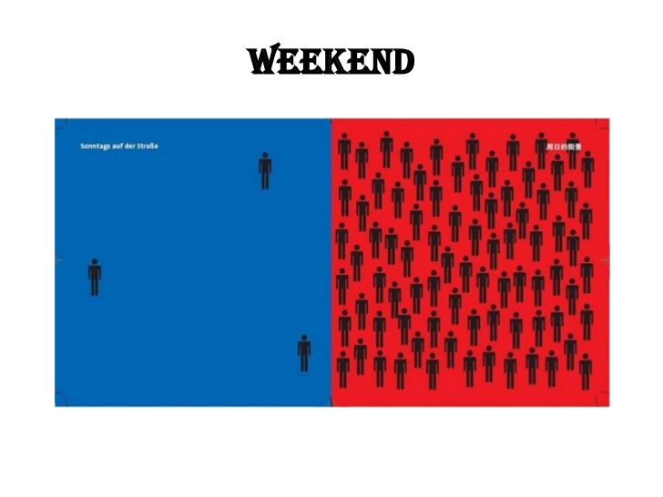
Weekends Free Time

Slide 10

Manners and Etiquette - Queuing
Queuing
排队
Notes:
West: Manors important (be polite)
East: Each for his/her own

Slide 11

Restaurant
In the restaurant
在餐厅

Slide 12
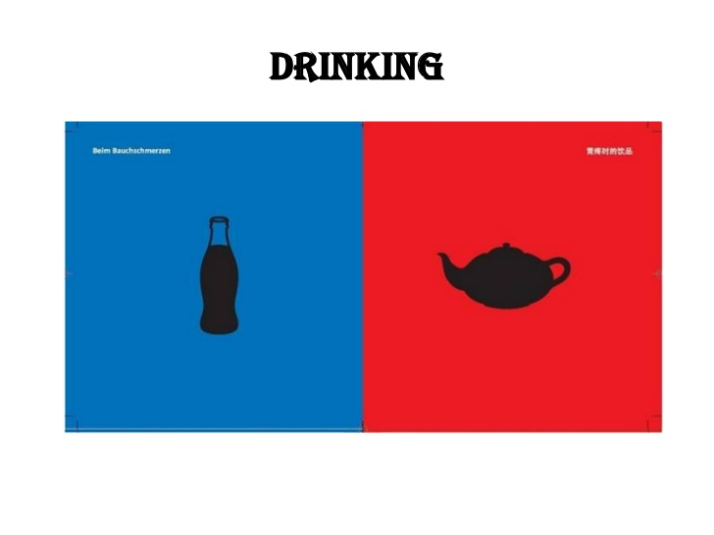
Cold vs. Hot Beverages

Slide 13
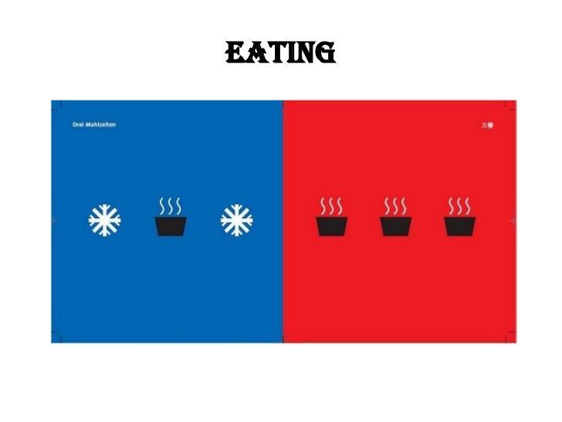
Cold vs. Hot Foods
Notes:
Salads

Slide 14
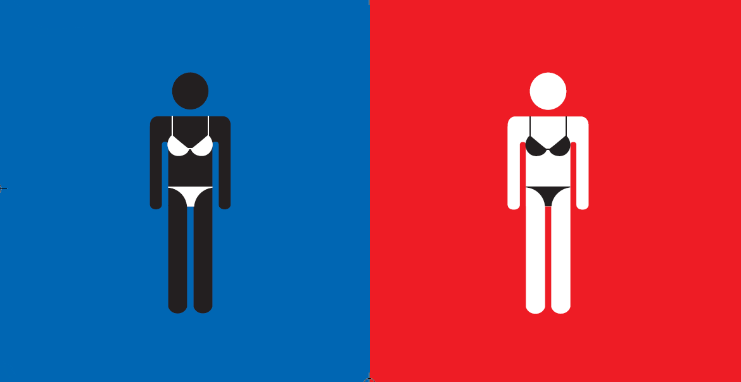
Tan skin indicates health and status
Standard of beauty
美丽的标准
Notes:
West: like dark skin
East: like white skin

Slide 15

Approaching a problem, challenge
Way to solve
problems
处理问题

Slide 16

Employee view of a manager
Boss
领导

Slide 17

View of a Child
The child
孩子

Slide 18
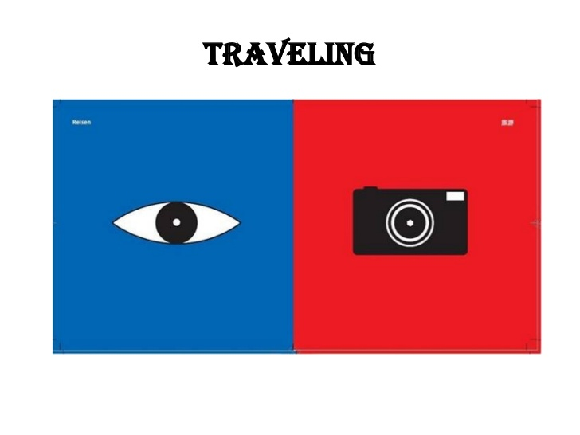
Linger vs. Record

Slide 19
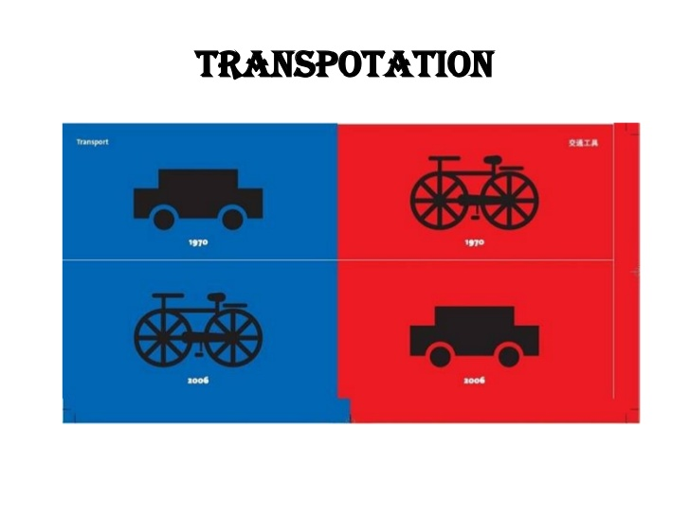
Lifestyle Choices
Notes:
For health, to preserve the Environment

Slide 20
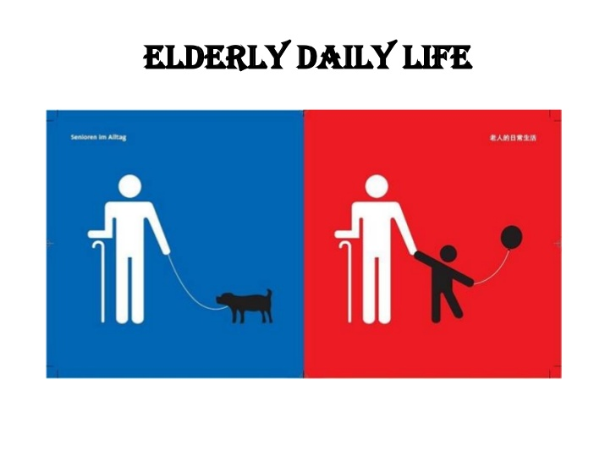
Senior Citizen Lifestyles

Slide 21
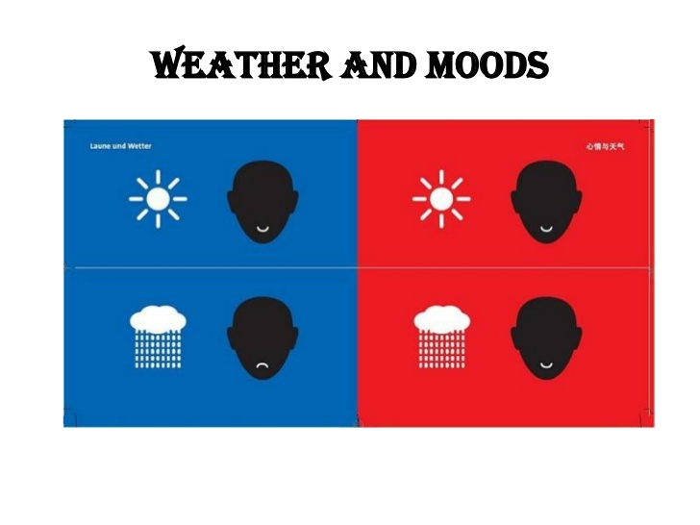
Sensitive to Weather

Slide 22
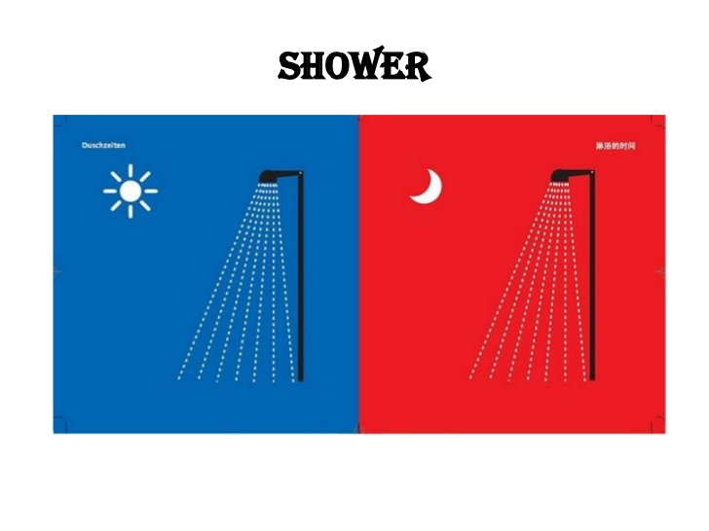
Bathing Habits

Slide 23
Western Communication
1. Speak slowly, maintain eye contact
2. Use objective, accurate language
3. Restate your questions and answers
4. Repeat other people’s questions
5. Ask questions! Ask for help!
Notes:
Culture is communication and communication is culture. Remember, you look like Americans to me. Westerners assume you speak English and are American!

Slide 24
In Class Assignment
Teams of four will spend ten minutes and the leader will present the answers to:
“Do in Rome as the Romans” means
“Time is money” means
Five strategies for effective communication with Westerners are:
Americans think you speak English because:

Slide 25
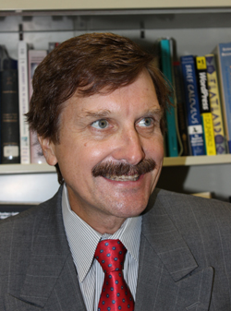
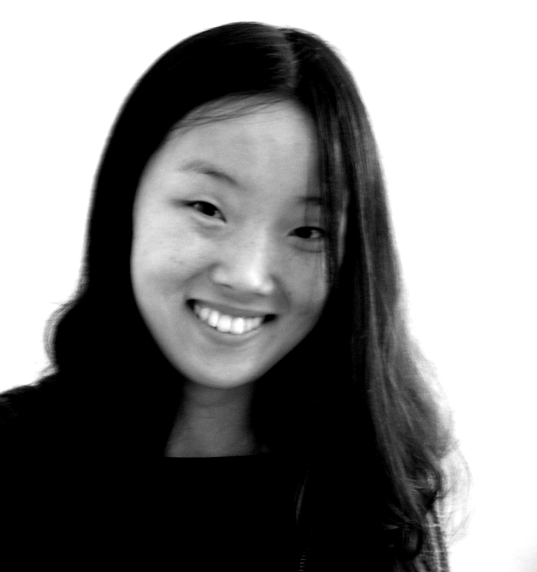
Preparing to Study and Work Overseas
Beihang University
Professor Dave Jaye
Illustrations by Yang Liu from “East meets West” book – www.yangliudesign.com
http://www.slideshare.net/thanhhuynh/east-vs-west-presentation
Notes:
What differences have you experienced?
http://www.slideshare.net/thanhhuynh/east-vs-west-presentation
25

Slide 26
What is Culture?
Society
Traditions
Religion
Politics
Art & Literature
Philosophy
Science & Technology
Ethical Values
Age
Education
Social Class
Organisation
Notes:
The word culture has many meanings:
In general it refers to a society's … (at a particular time and place)
Ethical Values – most cultures think killing is wrong but in some cultures in Columbia and Brazil certain tribes still practice cannibalism
Culture is learned, we are not born with it (but rather into it)
Culture changes over time (as we’ll see in a moment)
What our parent, grandparents and children think of culture will be different
Culture is more often a source of conflict than of unity
Understanding culture is the best way to avoid conflict
26

